Slide 1
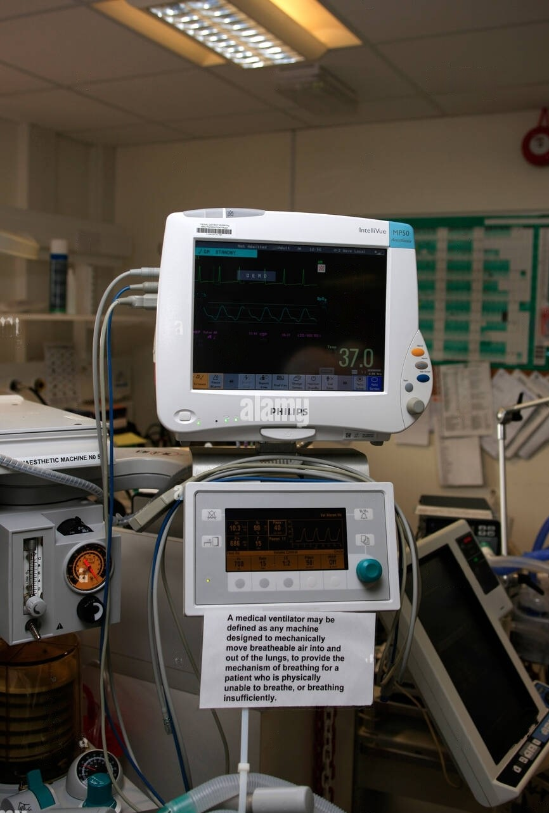
ECG MONITORING With Node MCU and AD 8232 Sensor
This presentation will guide you through the implementation of a ECG Monitoring System using Node MCU and AB 8232. By leveraging the Internet of Things (IoT), we can create a more accessible, efficient, and real-time system for ECG monitoring. This presentation will explore how the AD8232 sensor captures heart signals, how the ESP8266 enables wireless communication, and how these components together revolutionize the way we monitor heart health remotely.,
GROUP MEMBERS:
Arijit Dutta(22/ECE/054)

Slide 2
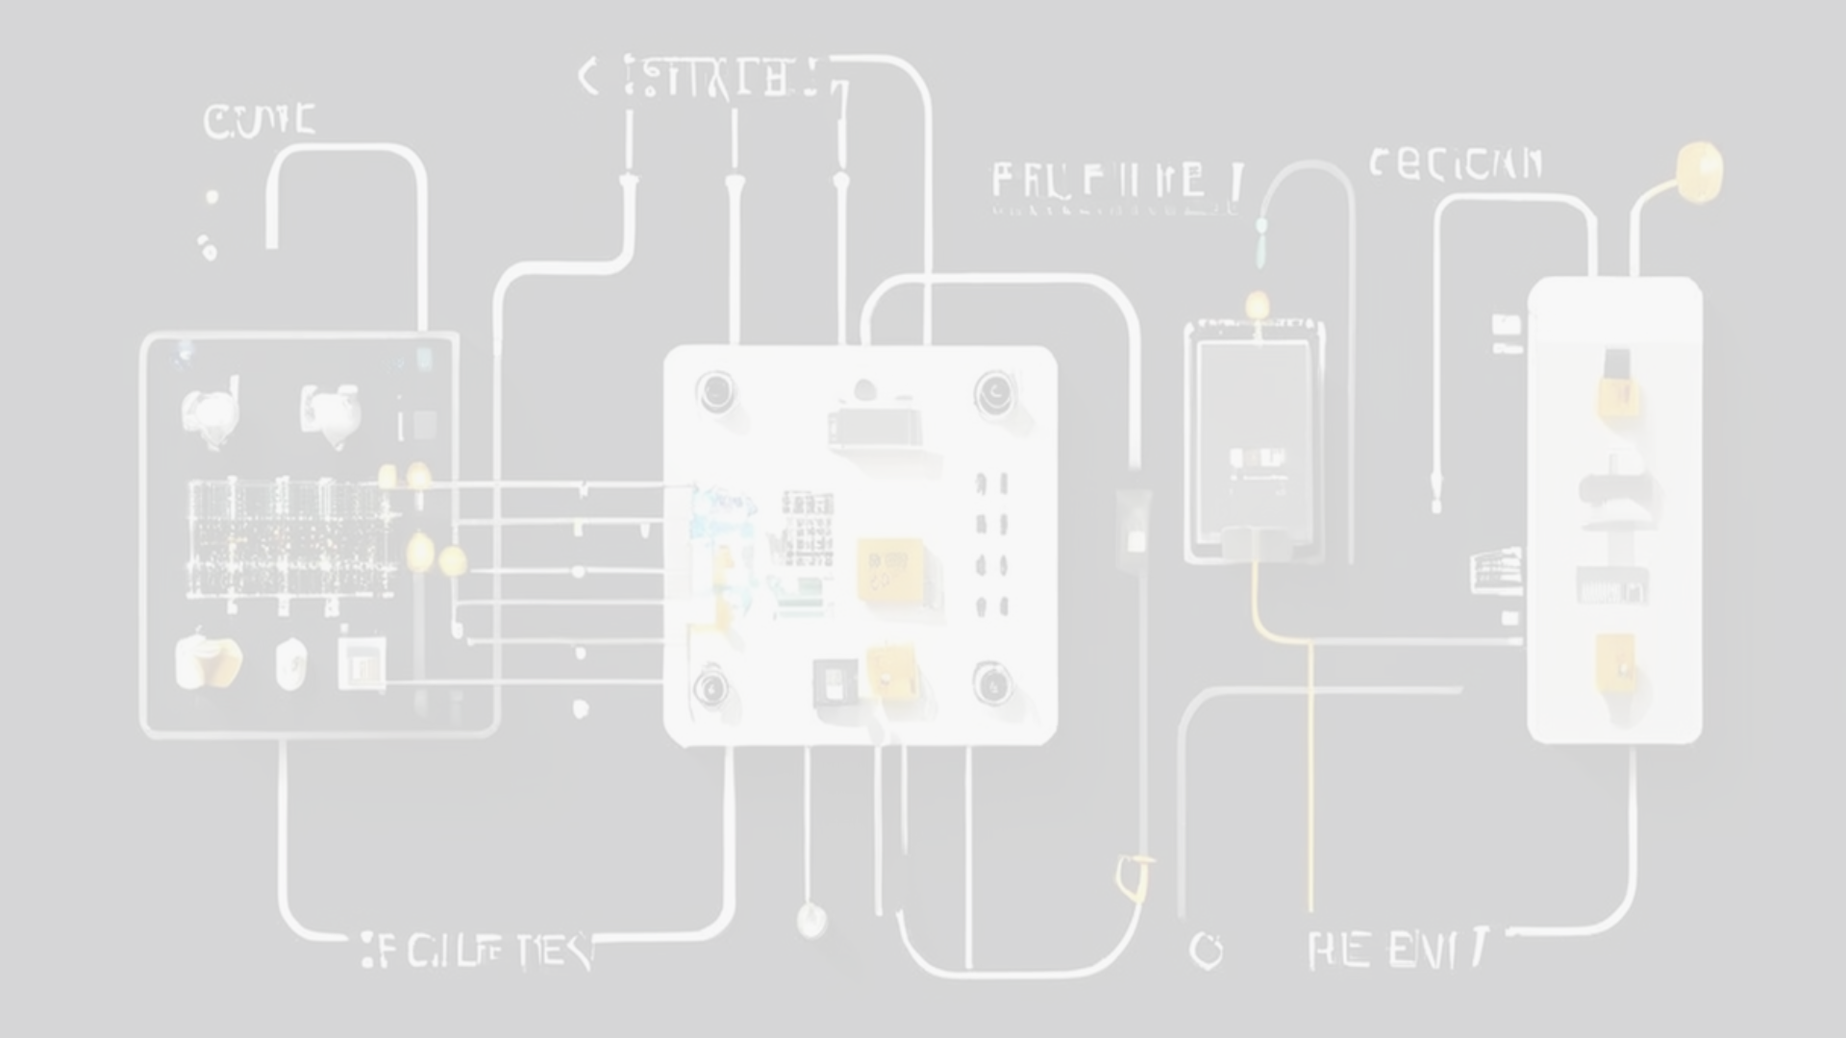
Reasons why we are implementing this:
1.Real-Time Health Monitoring: The integration of the AD8232 ECG sensor with the ESP8266 microcontroller enables continuous and real-time monitoring of heart activity, providing immediate insights and alerts for potential cardiovascular issues.
2. Remote Access and Convenience: Utilizing IoT technology allows patients and healthcare providers to access ECG data remotely. This reduces the need for frequent hospital visits and enables continuous monitoring from the comfort of a patient’s home.
3.Early Detection of Cardiac Issues: Continuous ECG monitoring can help in the early detection of arrhythmias, ischemia, and other cardiac conditions. Early intervention can significantly improve patient outcomes and reduce healthcare costs.
4. Cost-Effective Solution: The AD8232 sensor and ESP8266 microcontroller are relatively affordable components. Developing an IoT-based ECG monitoring system with these components can provide a cost-effective solution compared to traditional hospital-based monitoring systems.
5. Scalability and Flexibility: The use of the ESP8266, with its built-in Wi-Fi capability, offers scalability and flexibility. The system can be easily expanded or integrated with other IoT devices and healthcare systems, facilitating a comprehensive health monitoring ecosystem.
6. Improved Data Accuracy and Storage: IoT-based ECG monitoring ensures accurate and continuous data collection. This data can be securely stored and analyzed over time, providing valuable insights for long-term health management and research.

Slide 3
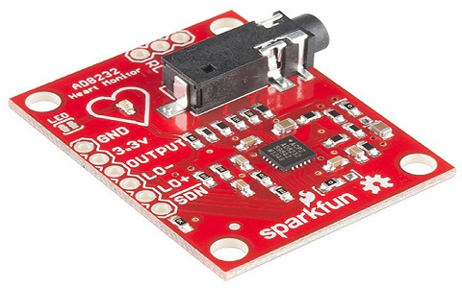
WHICH SENSOR WE ARE USING AND WHY?
We are using the sensor named AD8232. Some reasons are listed below to use it. Those are:
Integrated Design: The AD8232 integrates several components necessary for ECG measurement, including instrumentation amplifiers, right-leg drive amplifiers, and lead-off detection circuitry. This integration simplifies the design of ECG monitoring systems and reduces the number of external components needed.
Low Noise: The AD8232 has low input-referred noise, which is crucial for accurate measurement of the small electrical signals produced by the heart.
Single Supply Operation: It can operate from a single power supply, typically around 3.3V or 5V, making it suitable for battery-powered applications like portable ECG monitors.
Flexible Electrode Configuration: The AD8232 supports various electrode configurations, including three-electrode (lead I, lead II, lead III) and two-electrode (lead II) configurations commonly used in ECG monitoring.
5.Low Power Consumption: It consumes relatively low power, making it suitable for battery-operated devices where power efficiency is critical.
6.Cost-Effective: The AD8232 is cost-effective compared to designing custom ECG measurement circuits from discrete components, especially considering the additional features it provides.

Slide 4
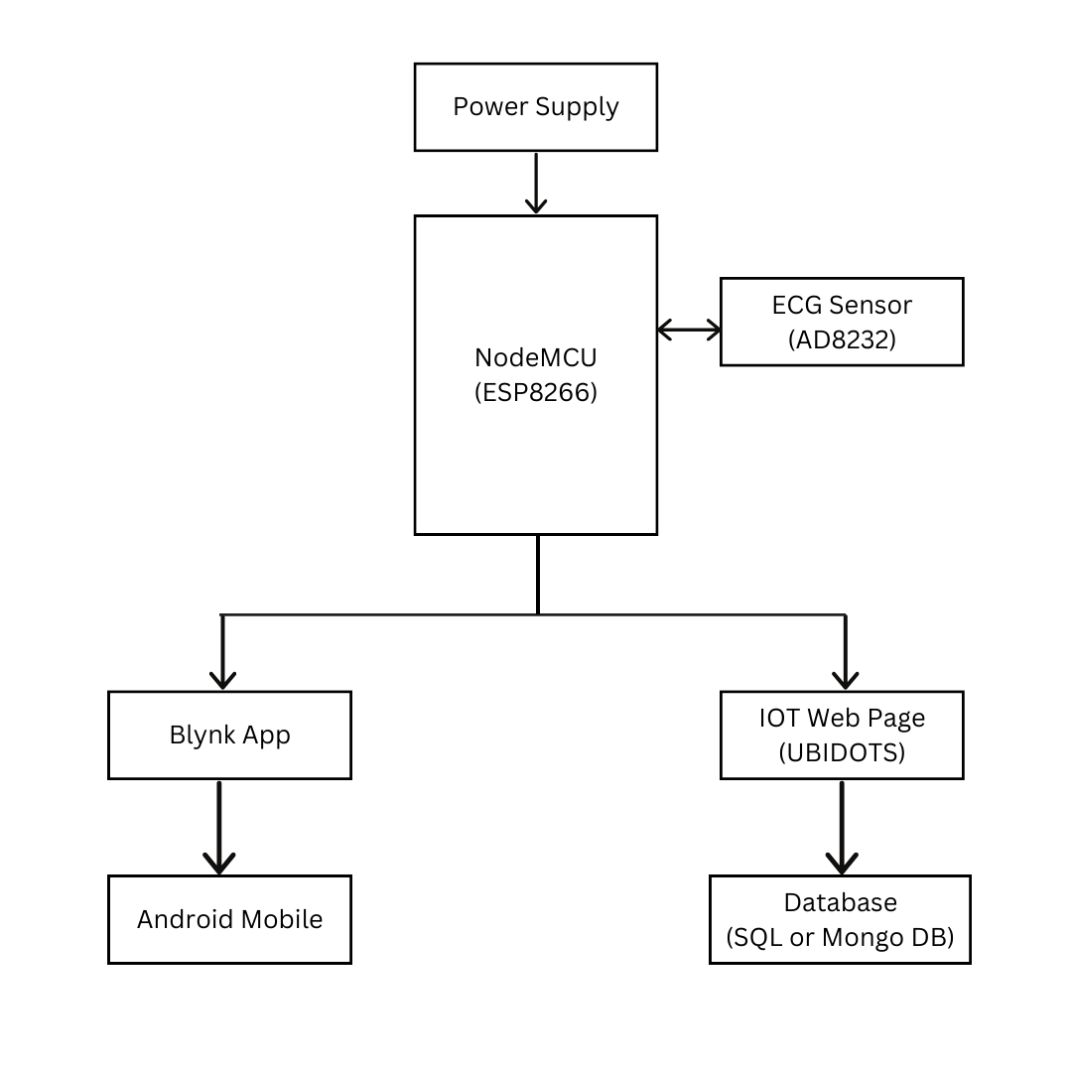
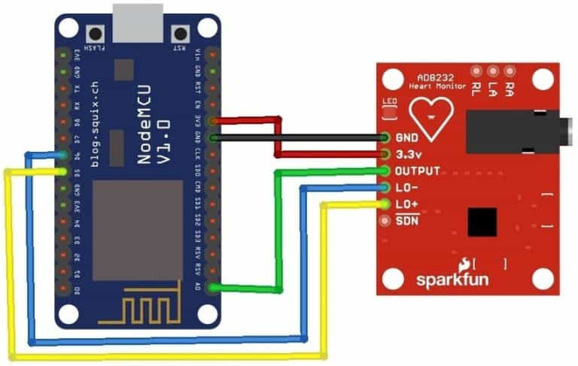
Circuit Diagram and Block Diagram

Slide 5
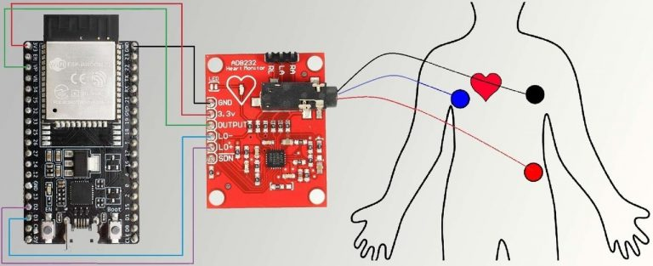
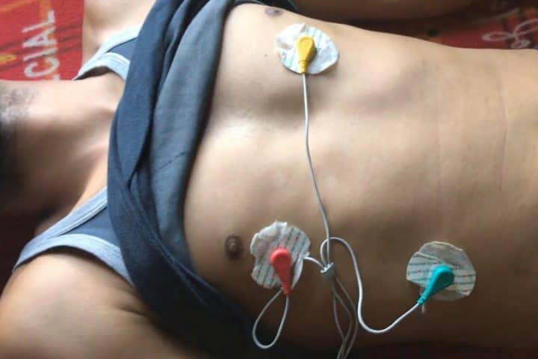
ECG Leads/Electrode Placement
AD 8232
NodeMCU
Human Body
We are placing the three electrodes in three locations which are left chest right chest and left Abdomen. These will tell us what is the reading of the ECG

Slide 6
Advantages and Use:
1. Provides real-time, continuous monitoring of heart activity, allowing for the detection of abnormalities as they occur, rather than relying on periodic checks.
Remote Access:
2. Enables healthcare providers to monitor patients remotely, reducing the need for frequent hospital visits and allowing for timely interventions based on real-time data.
3. Facilitates the early detection of cardiac issues such as arrhythmias, ischemia, and other heart-related conditions, potentially preventing severe health events through prompt medical response.
4. Utilizes affordable components, making it a cost-effective alternative to traditional hospital-based ECG monitoring systems. This can significantly reduce healthcare costs for both providers and patients.
5. Enables the collection and storage of ECG data over long periods. This historical data can be analyzed to track heart health trends, aiding in better diagnosis and personalized treatment plans.
6. Can be integrated with other IoT healthcare devices, creating a comprehensive health monitoring system that provides a holistic view of a patient’s health.
7. Can be programmed to send alerts and notifications to healthcare providers or caregivers in case of detected anomalies, ensuring timely intervention and care.

Slide 7
THANK YOU

